Slide 1
Lesson 4
CSS Layout and Positioning

Slide 2
Agenda
Objective: Learn how to use CSS for layout and positioning of elements.
Topics Covered:
The box model: margins, borders, padding, and content
CSS positioning: static, relative, absolute, fixed
Using Flexbox for layout
Media Queries
Activity

Slide 3
The Box Model

Slide 4
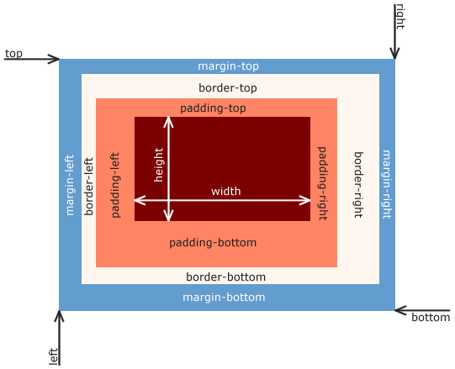
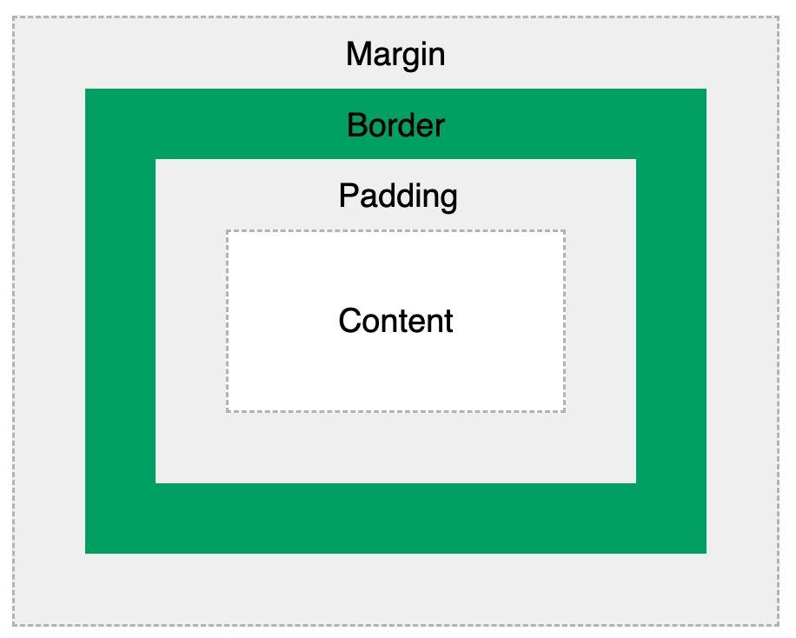
Box Model
a box that wraps around every HTML element

Slide 5
Box Model Parts
Content - The content of the box, where text and images appear
Padding - Clears an area around the content. The padding is transparent
Border - A border that goes around the padding and content
Margin - Clears an area outside the border. The margin is transparent
Allows us to add a border around elements
Define space between elements.

Slide 6
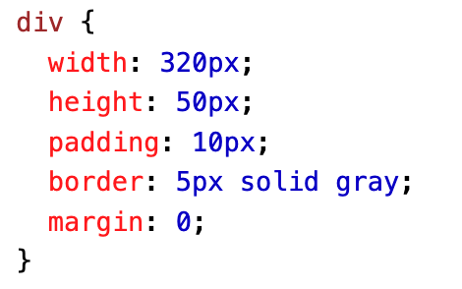
Width and Height of an Element
When you set the width and height properties of an element with CSS, you just set the width and height of the content area. To calculate the total width and height of an element, you must also include the padding and borders.
Total element width = width + left padding + right padding + left border + right border
Total element height = height + top padding + bottom padding + top border + bottom border
Total width and height of <div>?

Slide 7
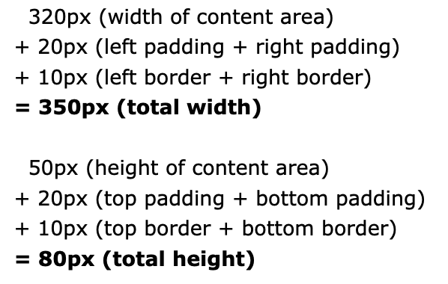
Solution

Slide 8
Quick Exercise
Copy HTML
<!DOCTYPE html>
<html>
<head>
<title>Box Model Exercise</title>
<link rel="stylesheet" type="text/css" href="style.css">
</head>
<body>
<div class="box">This is a box!</div>
</body>
</html>
Instructions (CSS)
Add padding of 20px.
Add a border of 5px solid black.
Add a margin of 15px.
Set the background color to lightblue.

Slide 9
Solution + Discussion Questions
.box {
padding: 20px;
border: 5px solid black;
margin: 15px;
background-color: lightblue;
}
How does changing the padding value affect the space inside the box?
What happens when you increase or decrease the border width?
How does adjusting the margin affect the space around the box?

Slide 10
Layout: the position Property

Slide 11
Static positioning
Default
Not affected by the top, bottom, left, right properties
Not positioned in any special way – just according to the flow of the page
position: static;
Example

Slide 12
Relative positioning
Positioned relative to its normal (would-be) position
Top, bottom, left, right: allow it to be adjusted away from normal position
position: relative;
Example

Slide 13
Fixed positioning
Positioned relative to viewport
Stays in the same place even if page is scrolled
Top, bottom, left, right are used to position it
Example (copy paste <p> a bunch of times)

Slide 14
Absolute positioning
Positioned relative to the nearest positioned ancestor (instead of relative to the viewport)
No positioned ancestors? It uses <body> and moves along with the page flow
Ancestor: an element that contains another specific element
E.g., in the example, the outer div is the ancestor of the inner div
Example
If the outer div did not have position: relative; the inner div would be positioned relative to the viewport, not the outer div.

Slide 15
Sticky positioning
Positioned based on user scroll position
Toggles between relative and fixed
Relative until a given position is met in the viewport
Then, fixed (sticking in place)
position: sticky;
Example

Slide 16
Flexbox
For responsive web design

Slide 17
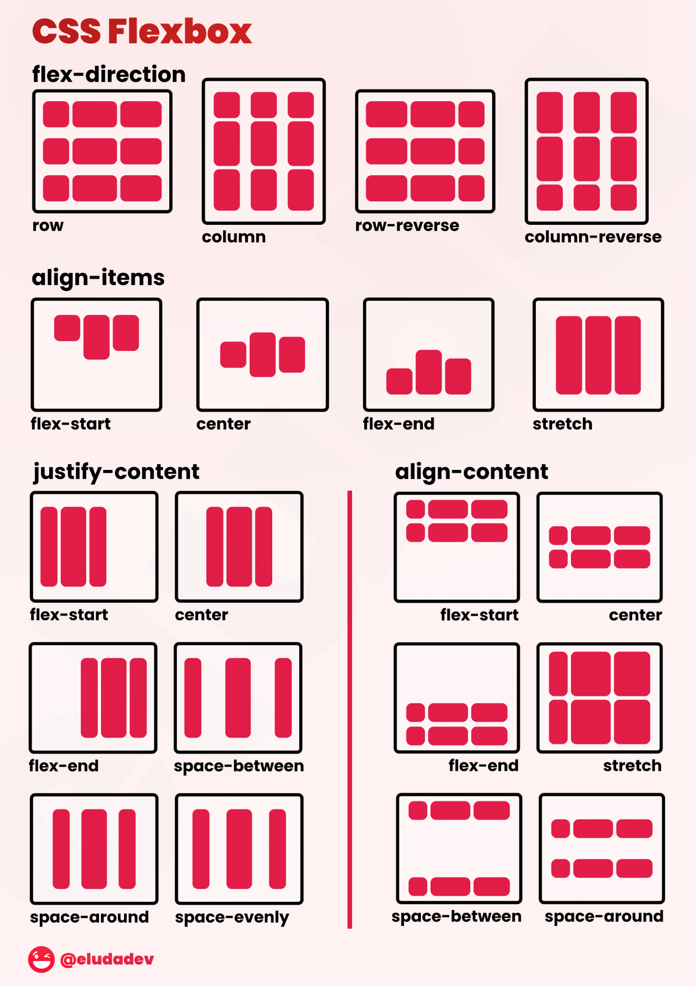
Intro to Flexbox (Cheatsheet →)
Allows responsive elements within a container to be automatically arranged
Based on viewport (visible screen) size
Flexible box
Manipulate spacing, alignment within container
display: flex; enables it

Slide 18
Flexbox Exercise
Fork this code/copy it on your own device: code
Watch this video and follow along
Notes:
Video summary

Slide 19
Media Queries

Slide 20
Media Queries
Watch this video to go over this topic. Still need help? See this article.
A technique that includes a block of CSS properties if a condition(s) is met
Check width and height of viewport, orientation of device
@media only screen and (max-width: 600px) {
body {
background-color: lightblue;
}
And: see if both conditions are true. If the browser window (screen) is 600px or smaller, the background color will be lightblue.

Slide 21
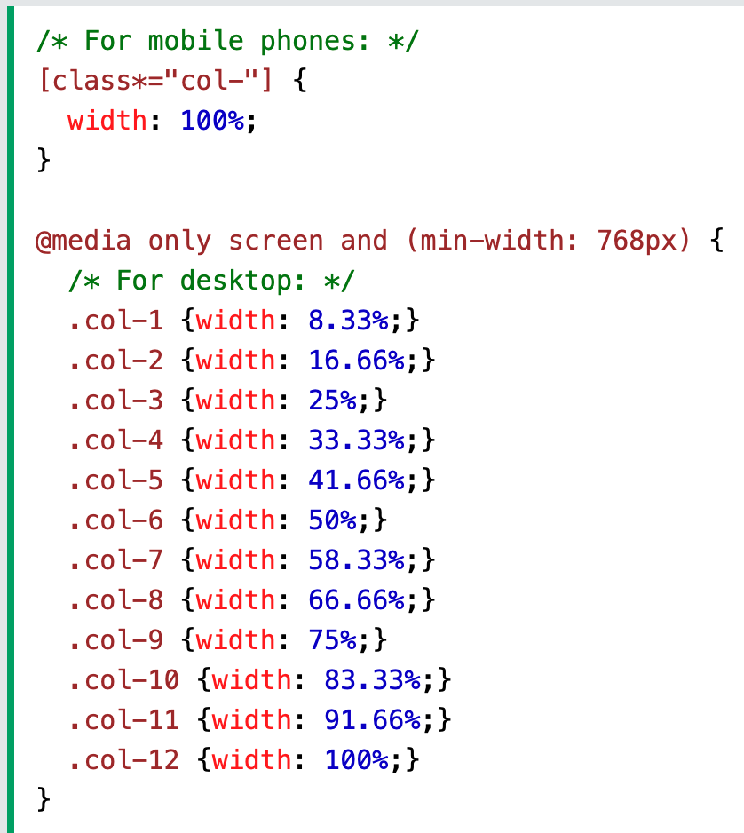
Media Queries (cont.)
Checking orientation with media queries
Responsive breakpoints (for making the webpage respond differently and rearrange its content according to viewport size)

Slide 22
Media Query Breakpoints Activity (cont.)
Here’s the link to the full code (this is the solution, don’t look at it yet)
Copy the template code on your own device (fork the repl or copy paste)
Exercise:
(already done for you) For screen sizes 600px and down, make the background red
(already done for you) For screen sizes 600px and up, make the background green
For screen sizes 768px and up, make the background red
For screen sizes 992px and up, make the background red
For screen sizes 1200px and down, make the background red

Slide 23
Activity

Slide 24
Making your All About Me web page responsive
Requirements:
Implement the box model in the parts of your All About me webpage, e.g. all the headings, the three different sections (Bio, Favorite Things, Quiz), images
Use the position property somewhere at least twice (no static positioning)
Use flexbox somewhere at least once
Notes:
Make at least one aspect/part of the web page responsive (see the media query activity)
Extra credit: Have the arrangement of your content change with media query breakpoints (for smaller/bigger screen sizes)
*add this for tomorrow

Slide 25
Thanks & Happy Hacking!

